Slide 1
COURSEWORK ST2187 Business analytics, applied modelling and prediction 2024–2025 5 dashboards
Student number:230698943

Slide 2
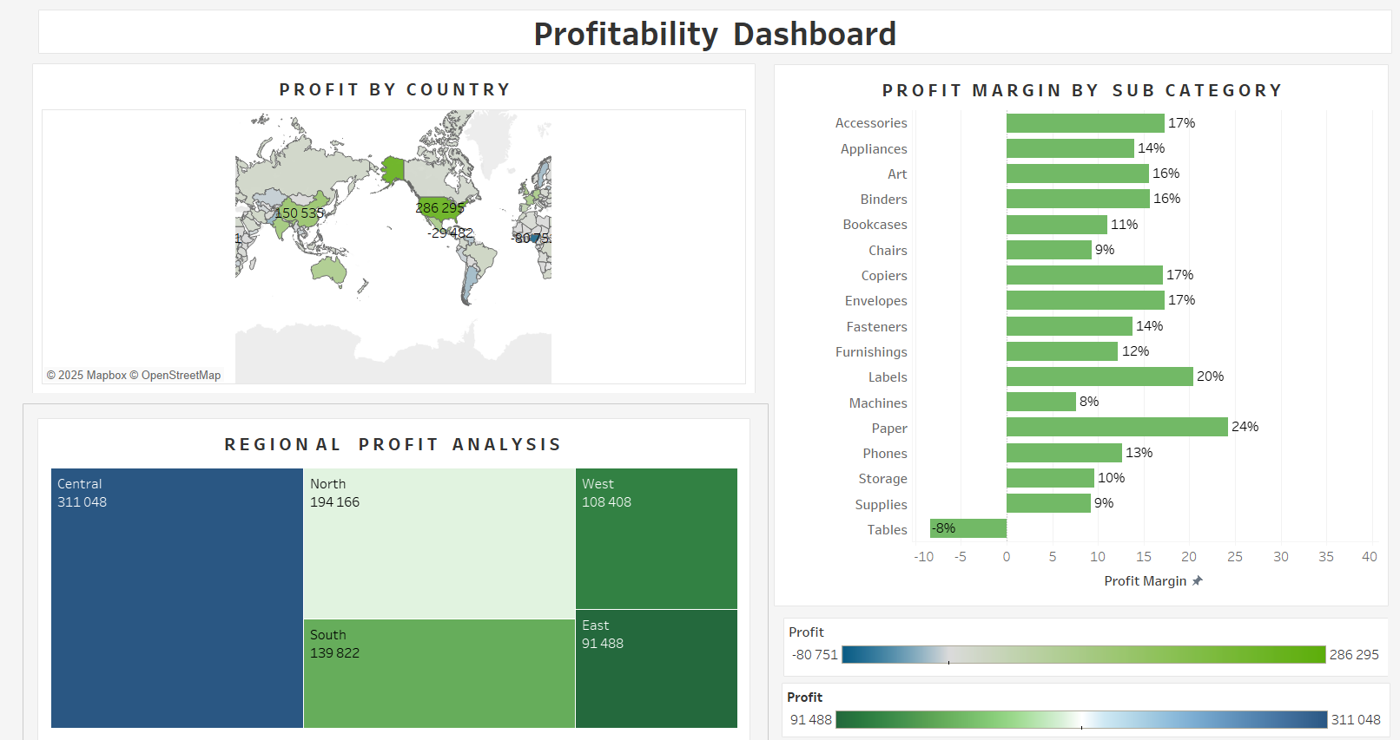

Slide 3
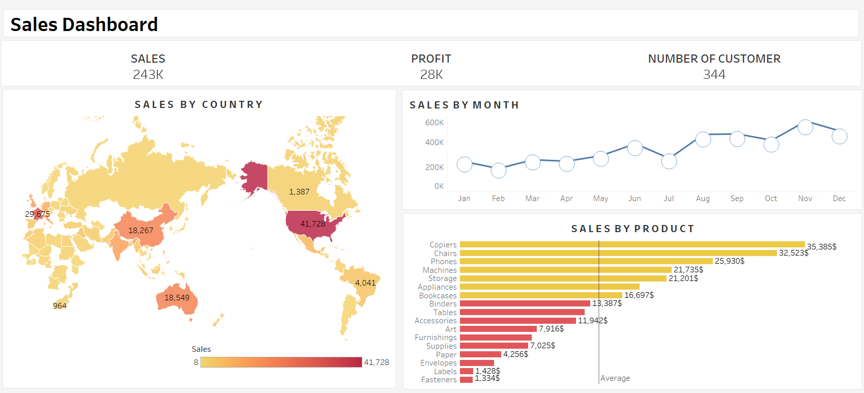

Slide 4
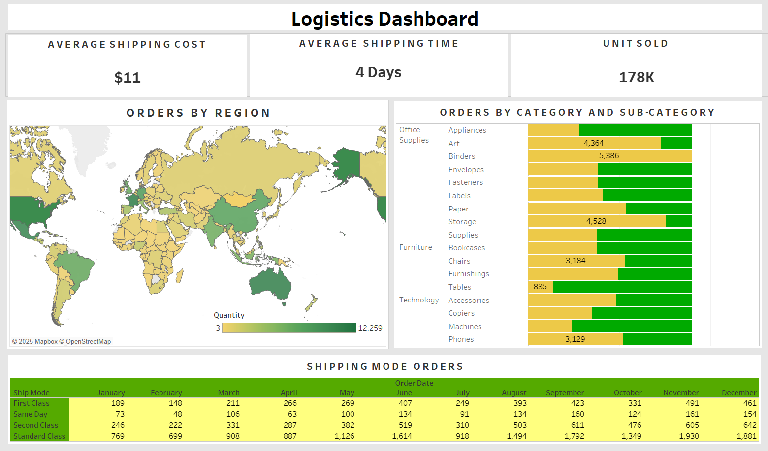

Slide 5
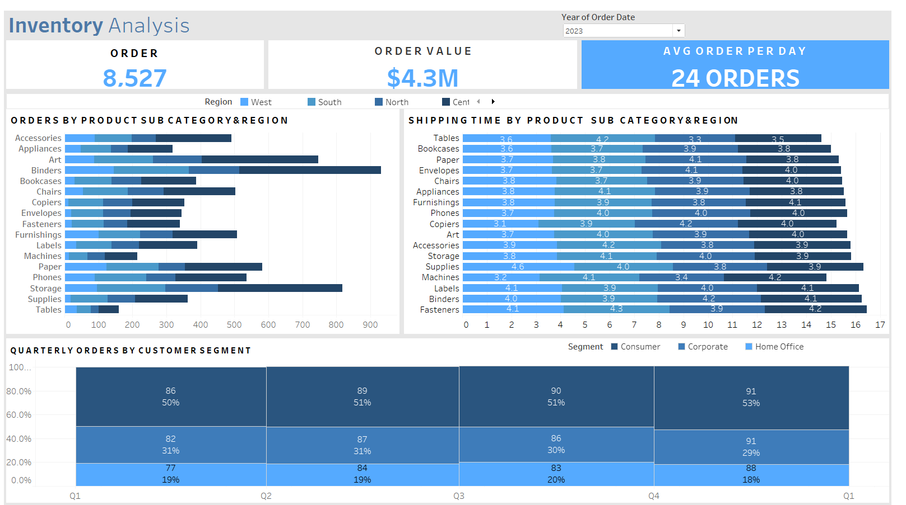

Slide 6
